Slide 1
Where are Houses Most Affordable?
By: Bestor McFadden, Cameron Webb, Collin Tice, Ethan Tice, and Jonathan Folger

Slide 2
Why Is This Important to Know
Younger Americans are feeling the difficulty in owning a house
  Average age of first-time buyer is 38
  Wealth gap contributes
Owning a house is one of the biggest ways to have generational wealth
  Equity Growth
  Security
  Transferable Asset
Salaries have not been able to keep up with this increase
  This will be demonstrated later

Slide 3
Data Sources Used
Median housing prices -> RedFin housing data
Median Household Income -> US Census Bureau
GDP -> Bureau of Economic Analysis (US Department of Commerce)
CPI -> U.S. Bureau of Labor Statistics
Income tax rates -> taxfoundations.org

Slide 4
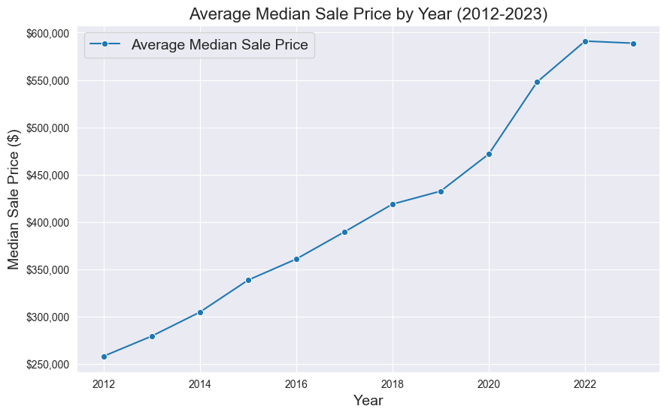
Combined City Trends

Slide 5
Median Housing Prices Data Prep
Downloaded the data from RedFin housing for the years 2012-2023
Imported the excel into python to clean
  Getting the right columns (Region, Year, Median Sale Price)
Made sure the data was the right type of data
Took the median of the housing prices and grouped them into the same year and region
Standardized the 'Region' column
Graphed the results

Slide 6
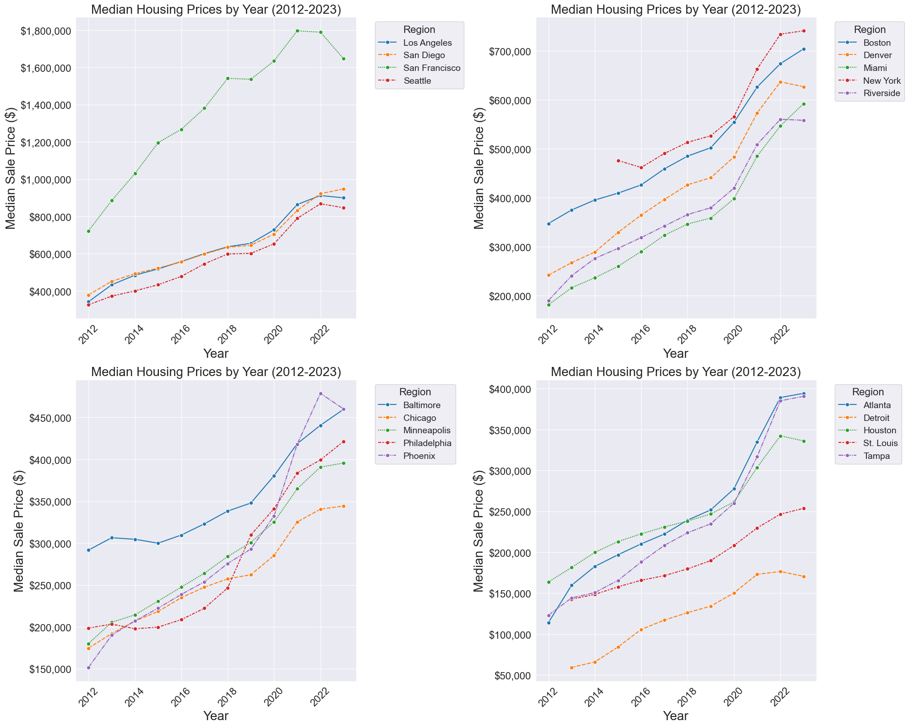
History of Housing Prices
In 2012, the median housing prices were significantly lower than 2023
We see above a 200% jump in the cost of houses over the last 10 years

Slide 7
Median Household Income Data Prep
Pulled data from US Census Bureau into excel
  Combined data
*Data issues and solution
Formatted the data so it could be easily worked with
  “Melted”
  Formatting
Used a line plot to analyze trends

Slide 8
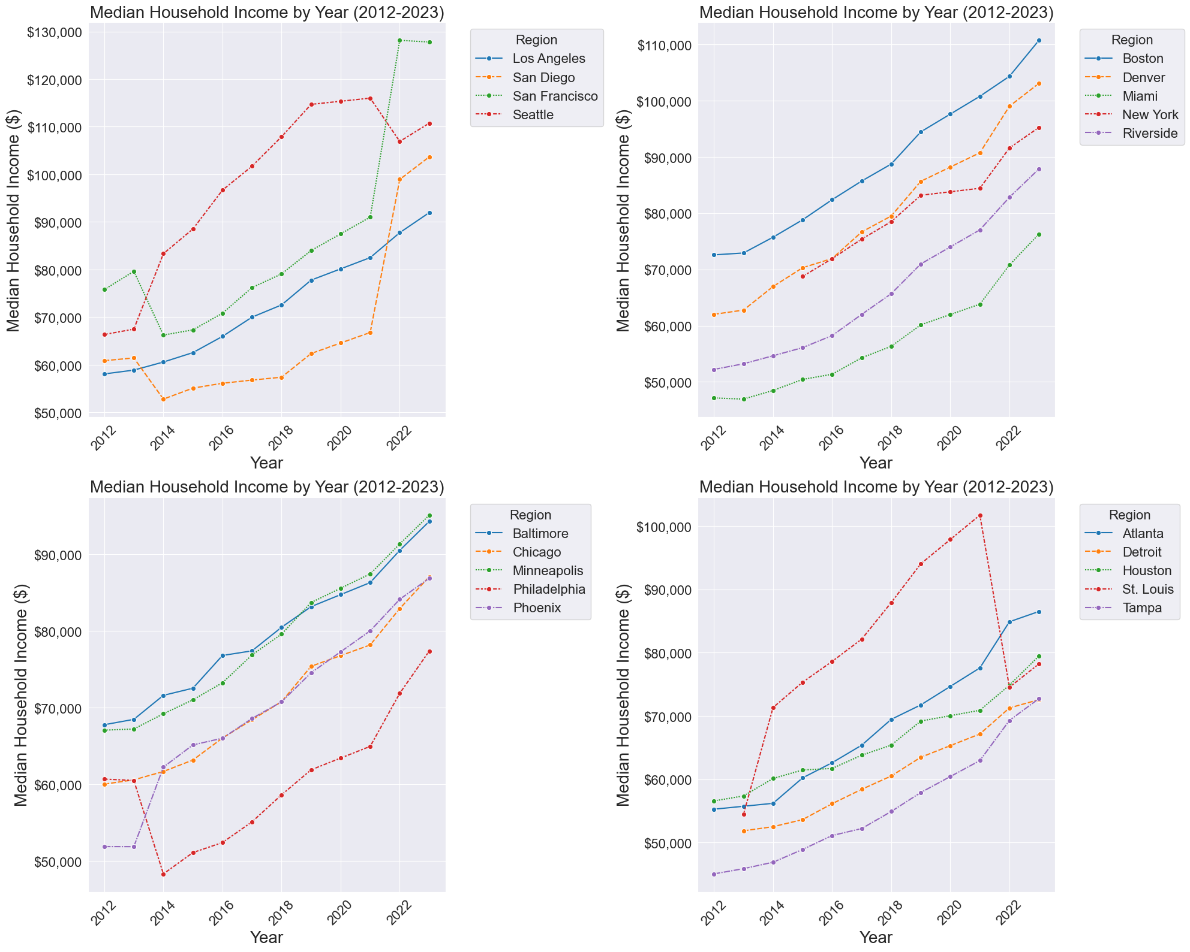
History of Household Income
Salaries have increased, but not nearly as much as housing prices
Salaries only have around a 50% increase in the last 10 years

Slide 9
CPI Data Prep
Imported and cleaned up the excel files
Filled missing values
  Riverside, Baltimore, and Washington DC
Created one master data frame
Melted the data
Graphed out the results

Slide 10
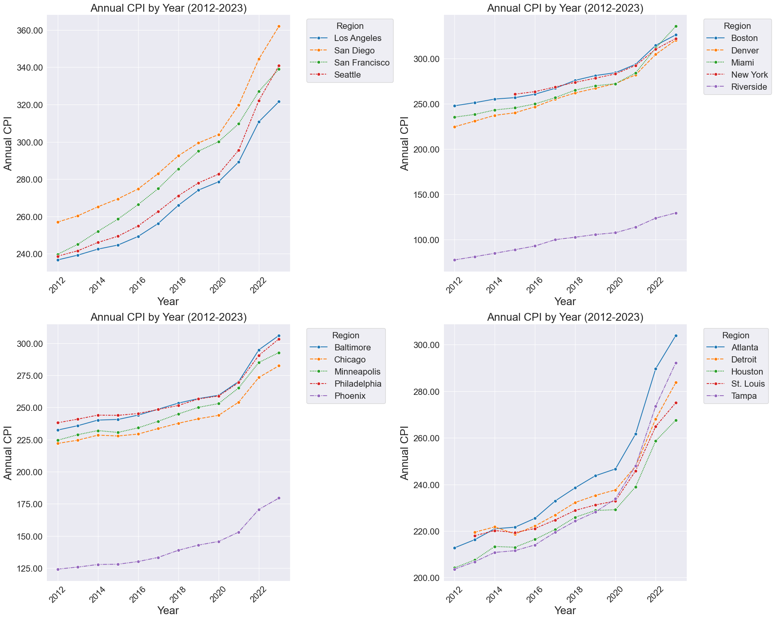
History of CPI
CPI has generally increased among all regions over 2012-2023
Riverside region is overall the lowest by far and San Diego is the highest followed by San Francisco

Slide 11

GDP Data Prep
Raw data from BEA included top 20 Metropolitan Statistical Areas in the United States (2012-2023)
  Variables: Current GDP, chain index, and Real GDP
Data cleansing in excel - removing headers/notes, removed the chain index variable
Python - reshape and reformat the data
MSA names were standardized
Notes:
*Speaking notes in OneNote*

Slide 12
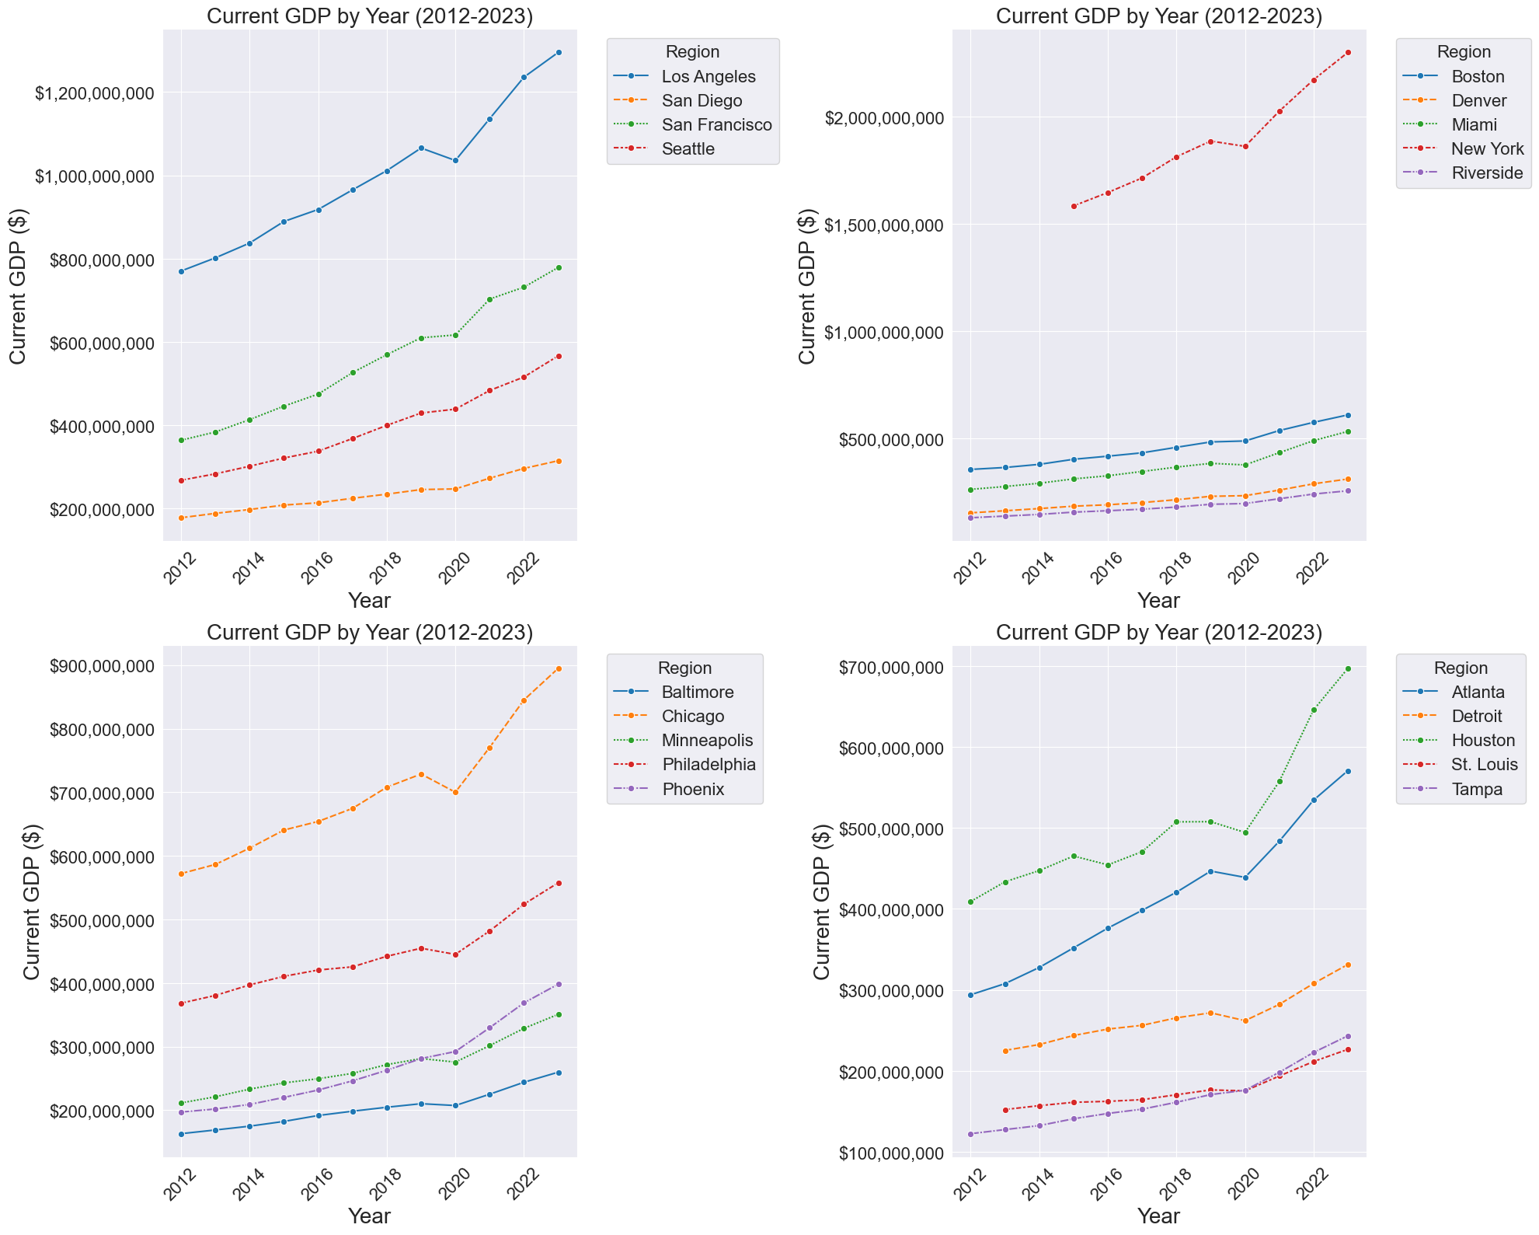
Trends of Current GDP
Quick Observations
Larger cities dominate GDP (New York, LA, San Francisco)
New York and Chicago – high GDPs, lower housing prices compared to group one

Slide 13
Income Taxes Data Prep
Raw data from Tax Foundation included state income tax rates from 2012-2023.
For each city:
  Year variables
  Corresponding state income tax rate (assuming $70,000 income)
Sorted cities from A to Z, then year ascending.

Slide 14
Potential Issues
Differing Metropolitan Statistical Areas
Data lag
Data overload
Confounding Variables

Slide 15
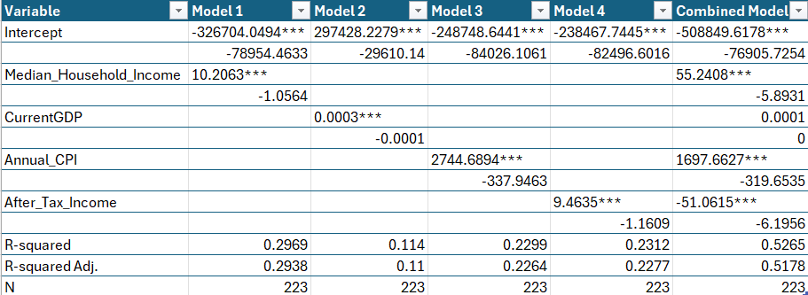









Regression on all our data
Combined the data into one table
Ran a regression to find how well these collected variables describe the housing price
What is R squared and what does it mean

Slide 16
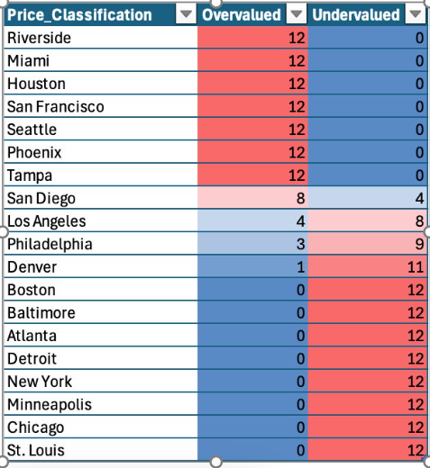
Overvalued vs Undervalued
Average Actual Price – Predicted = Overvalued (Undervalued)
Coastal, warmer climates mostly overvalued
Undervalued regions colder climates, relatively high crime rates

Slide 17
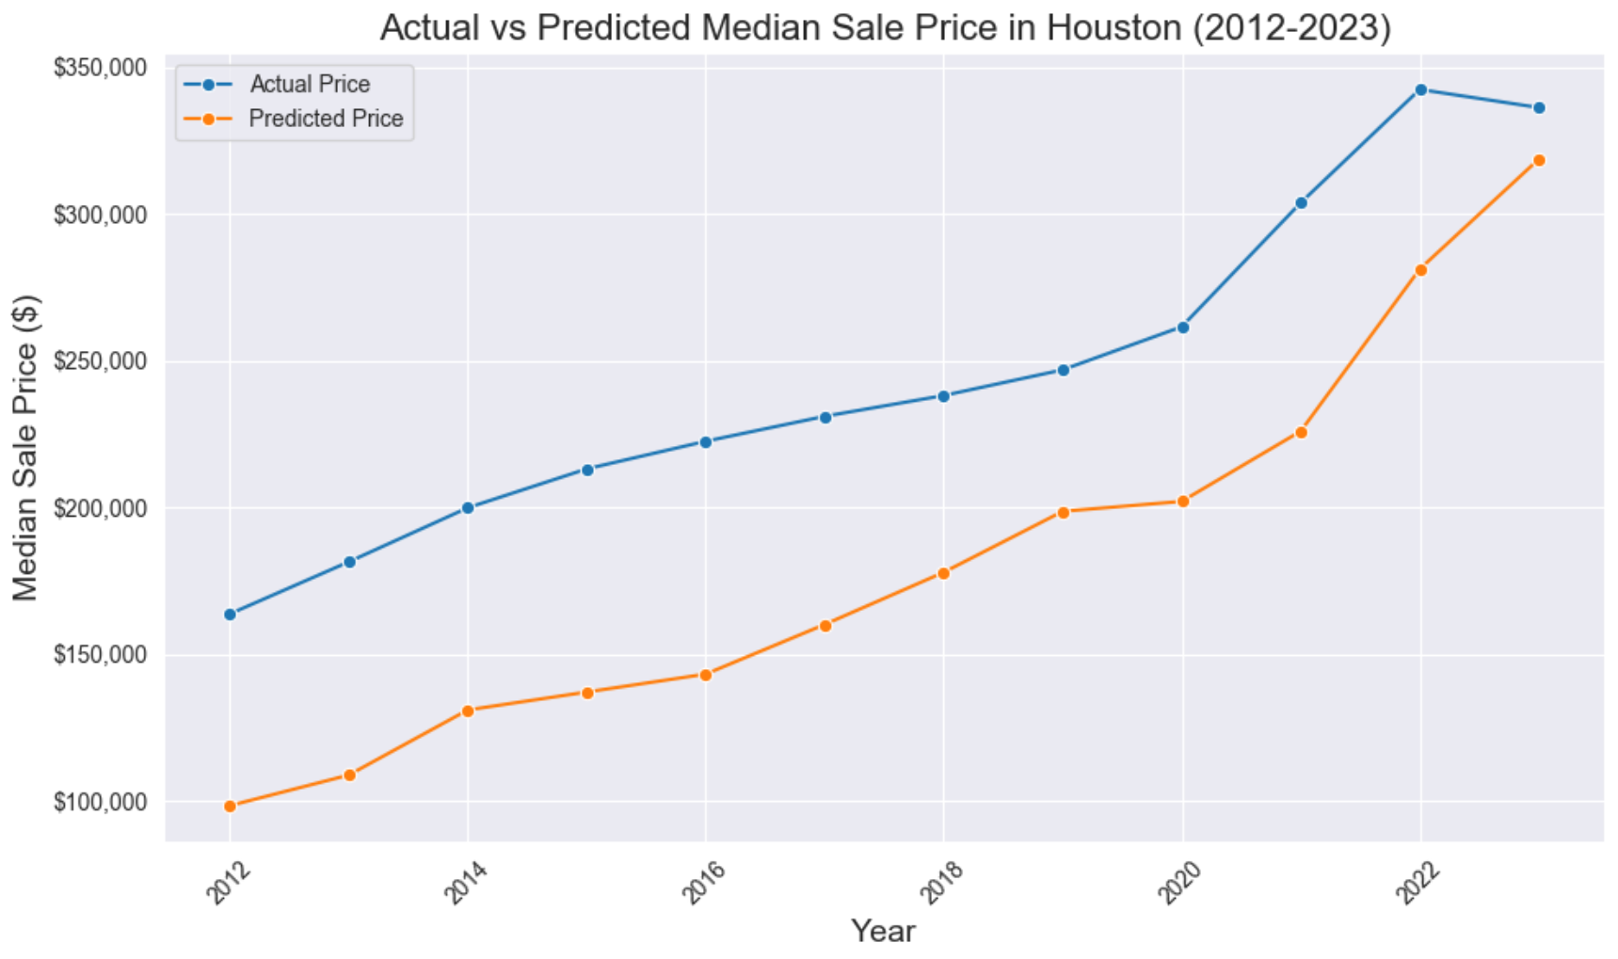
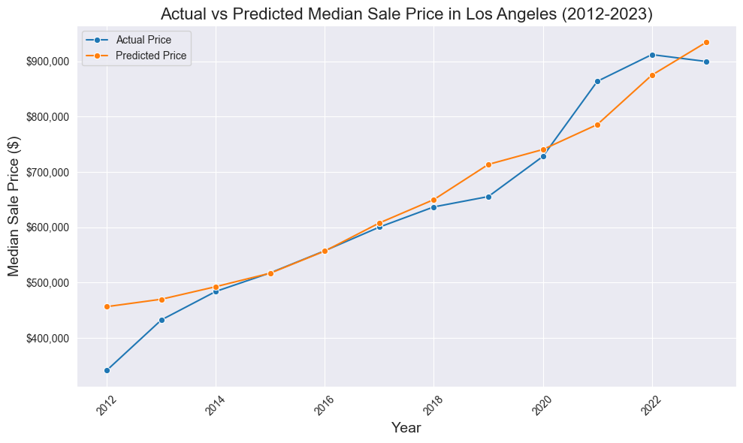
Fairly Valued
Houston
Los Angeles

Slide 18
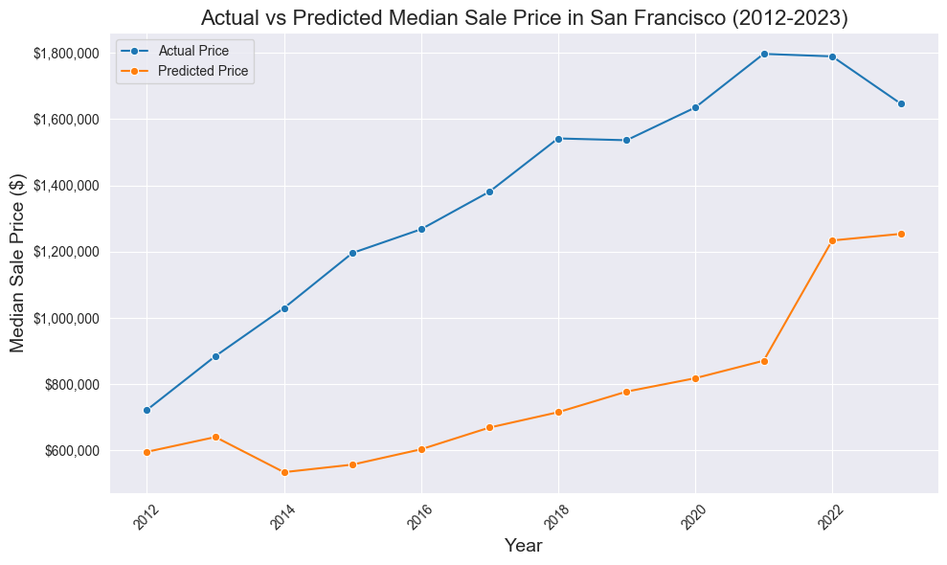
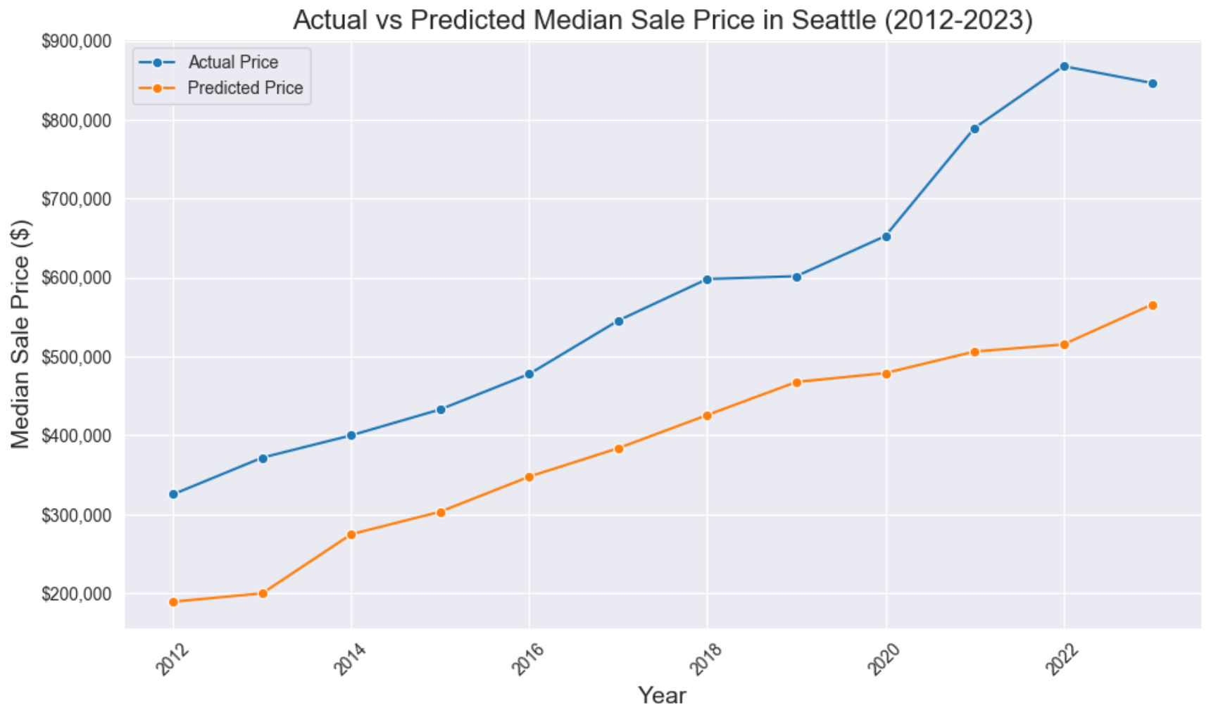
Overvalued
San Francisco
Seattle

Slide 19
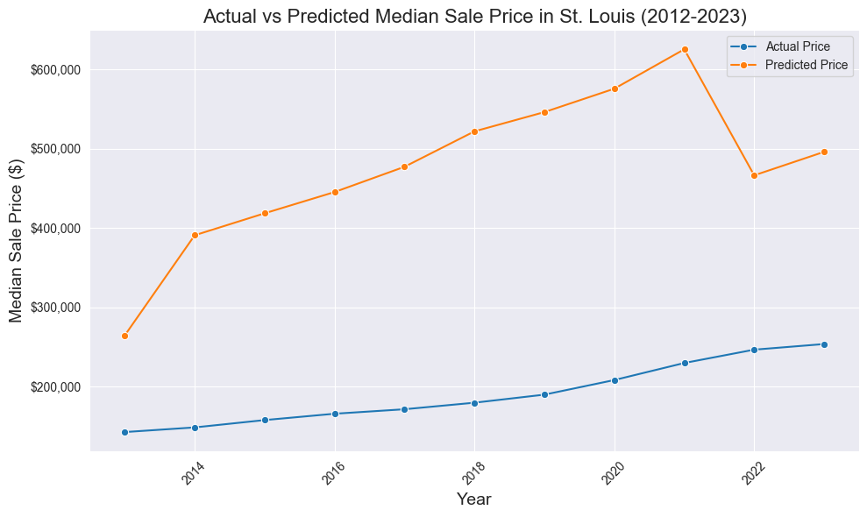
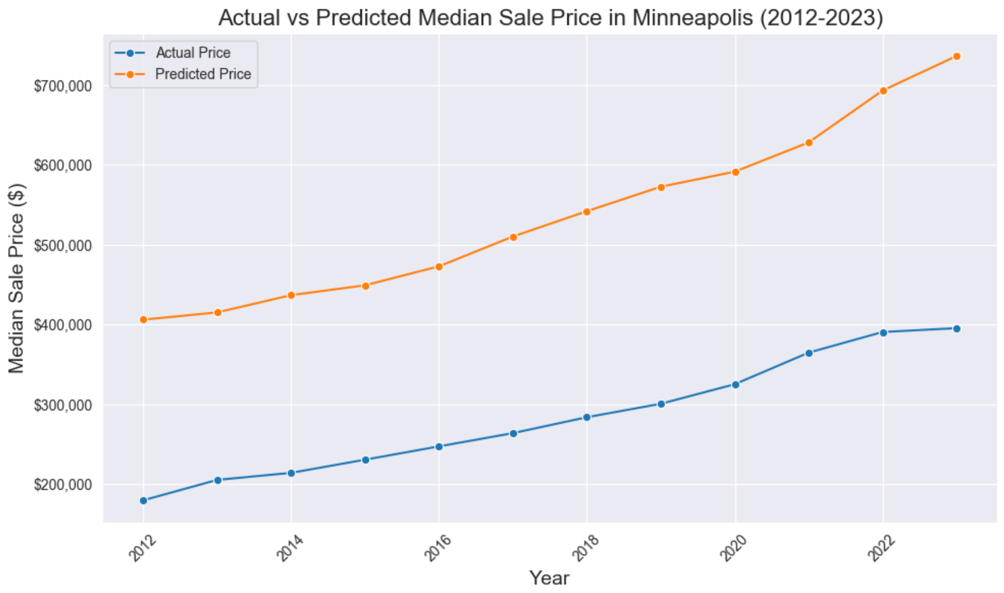
Undervalued
St. Louis
Minneapolis

Slide 20
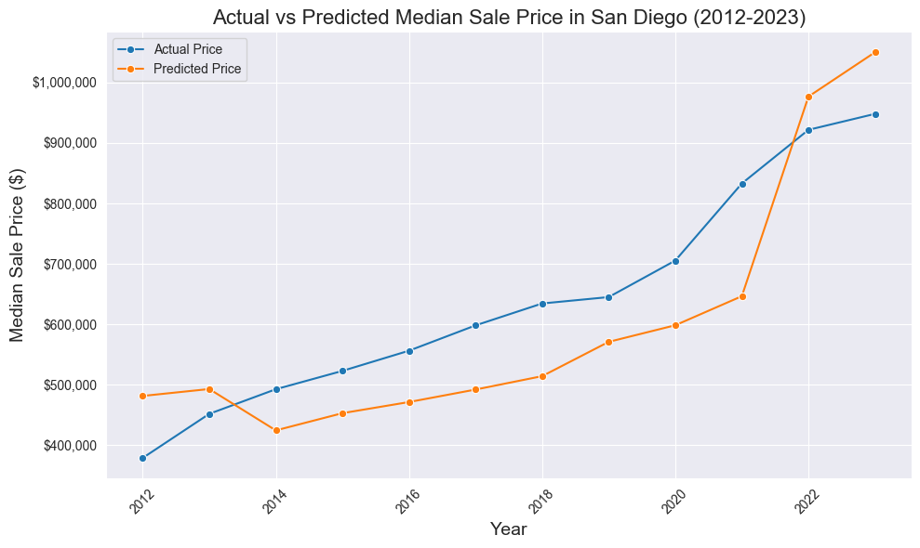
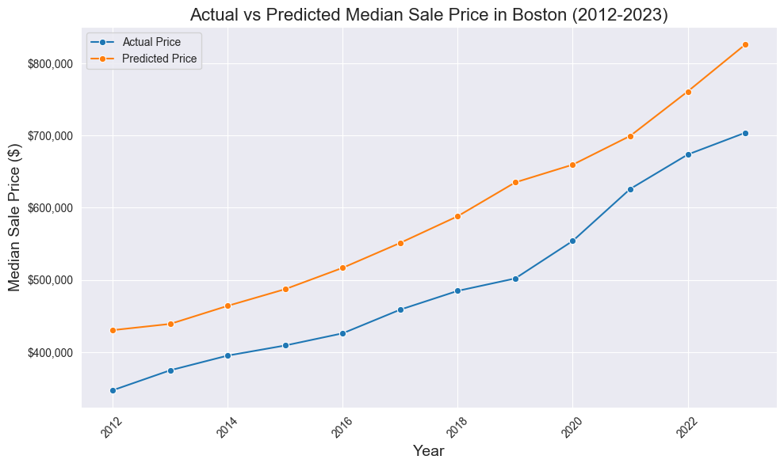
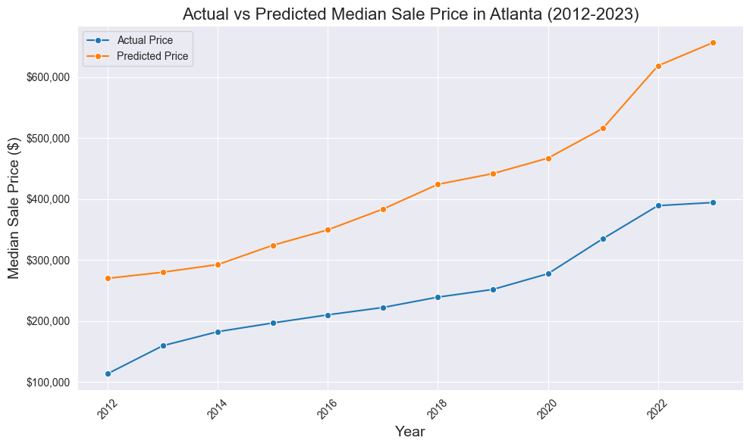
Recommendations
West
  San Diego
Northeast
  Boston
South
  Atlanta
Honorable mention
  Chicago

Slide 21

Any Questions?

Slide 22
Works Cited
Bureau, US Census. “Income Data Tables.” Census.Gov, 23 June 2025, www.census.gov/topics/income-poverty/income/data/tables.html.
Redfin. “Downloadable Housing Market Data.” Redfin News Data Center, https://www.redfin.com/news/data-center/.
Nau, Robert. “What Does R-Squared Tell Us about the Fit of the Regression Model?” RegressIt: Regression and Forecasting, Duke University, https://people.duke.edu/~rnau/rsquared.htm.
U.S. Bureau of Economic Analysis, "CAGDP1 County and MSA gross domestic product (GDP) summary" (accessed Sunday, December 7, 2025)
“State Individual Income Tax Rates and Brackets, 2025.” Tax Foundation, Tax Foundation, 18 Feb. 2025, taxfoundation.org/data/all/state/state-income-tax-rates/.
“State Individual Income Tax Rates and Brackets, 2016.” Tax Foundation, Tax Foundation, 2016, taxfoundation.org/data/all/state/state-individual-income-tax-rates-and-brackets-2016/.

